Slide 1
ACEP Phuhlisa
An example of a specific intervention
Garth van Heerden (ACEP)
Lukhanyiso Vumazonke (UFH)

Slide 2
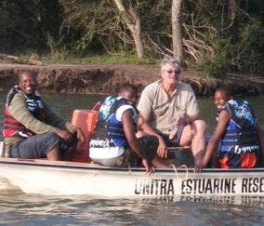
Overview
SA growing its
knowledge economy
NRF aims for
1% of global research
6000 PhDs per year by 2025
National Development Plan (2011)
more woman and African postgraduates
100 PhDs per million per year by 2030
Increase PhD qualified staff from 34% to 75%
Minister Hanekom emphasizes need for greater equity in awarding of bursaries

Slide 3
Overview cont…
Strategic imperative to:
increase the number of PhDs to increase SA’s research output.
have a representative research community

Slide 4
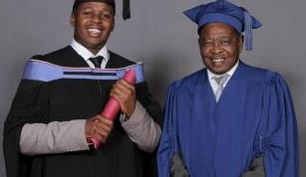
Challenges in HET
No. of Masters declining since 2004
No. of graduates declining since 2005
ASSAf report (2010) identifies barriers:
Poor quality schooling, undergraduate and post graduate pipeline
Institutional constraints: limited supervisory capacity
Poor monitoring to track progress
Financial & Administrative
High dropout rate

Slide 5
% Representivity Life Sciences

Slide 6
History of Phuhlisa
ACEP I (2002 - 2006)– Closed call with no transformation targets.
ACEP II (2007 - 2011)– Open call with transformation targets but limited success in terms of no. of Masters and PhDs produced.
SAEON/ACEP - Nasutus CSI programme (2007-2009), produced 2 Masters students supported BSc Honours, Zoology, UFH.

Slide 7
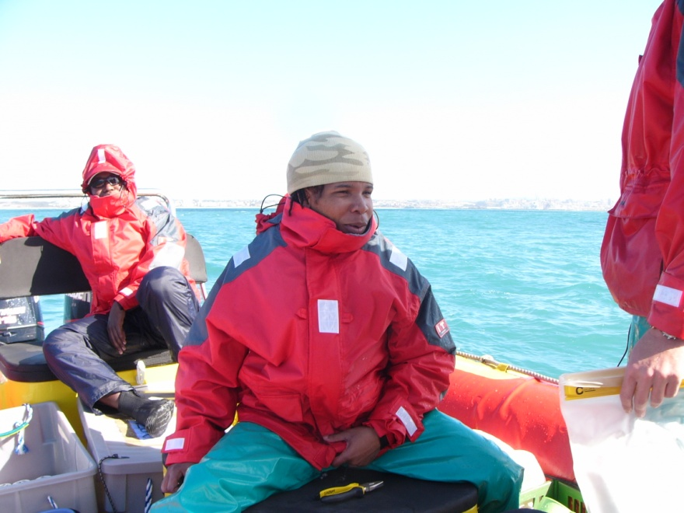
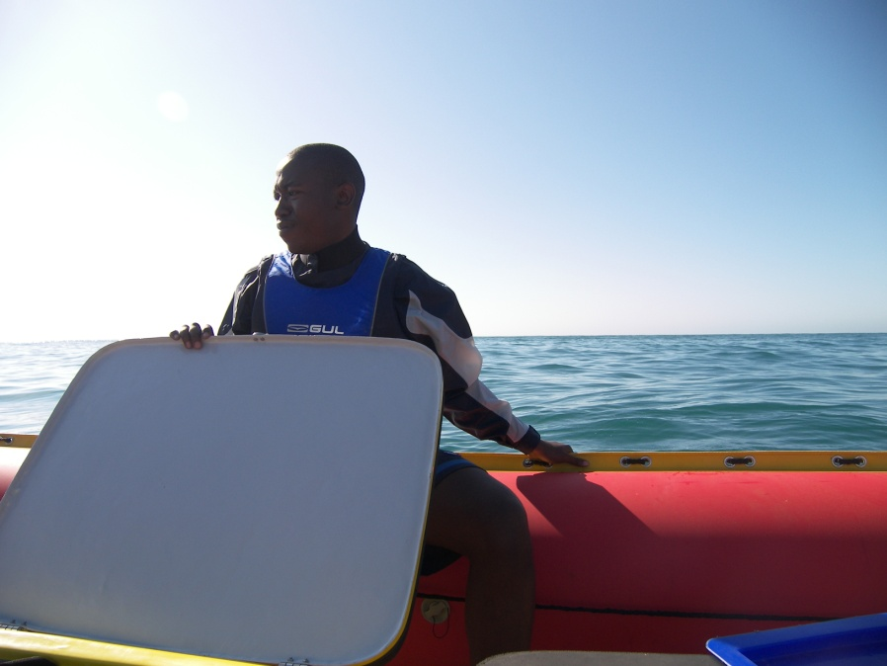
Successes of Nasutus CSI & ACEP II
Mr Luzuko Dali (MSc-Rhodes)
Mr Ntuthuko Masikane (MSc-NMMU) currently: PhD

Slide 8
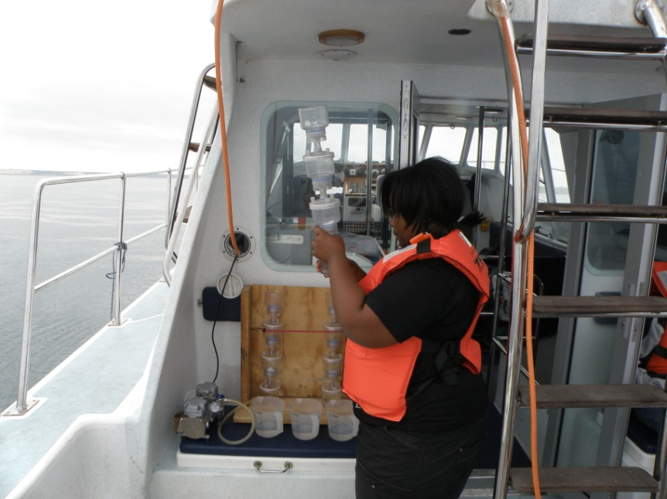
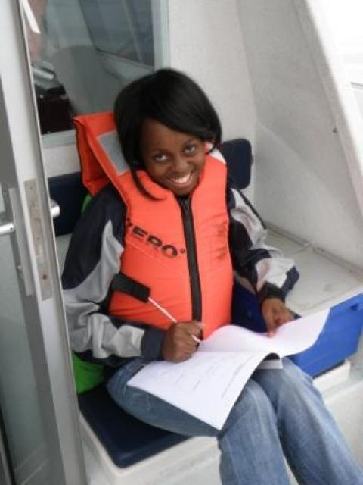
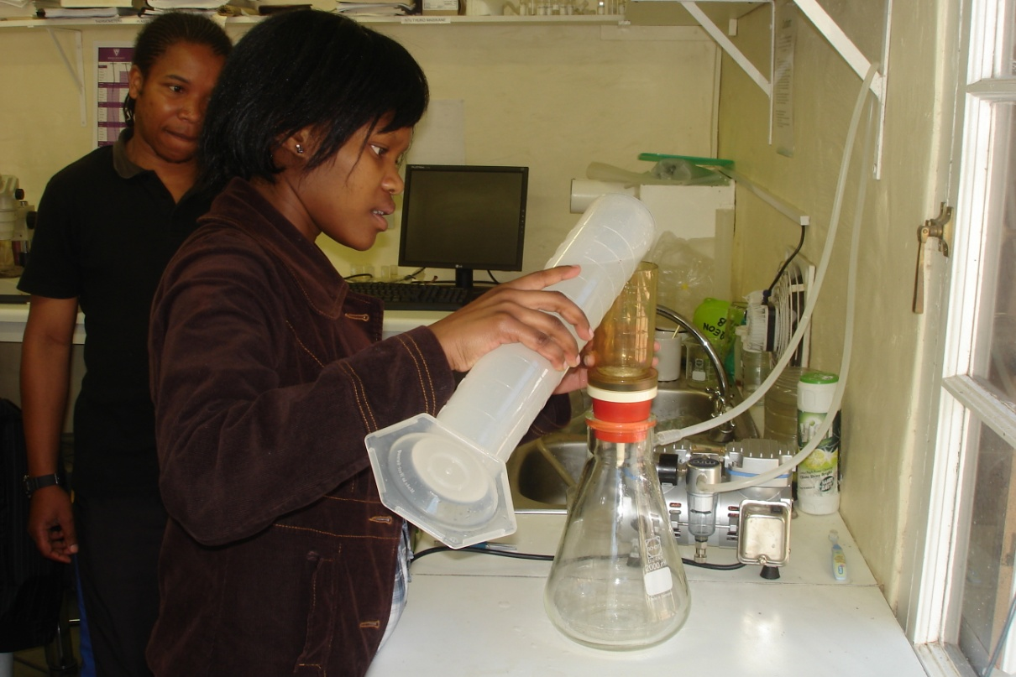
Mfundo Bizani Hons 2010
Zimkhitha Gebe – Hons 2010
Kwasa Ntongana
Hons 2011
Sesethu Mbekisa Hons 2011

Slide 9
Learning from our past experience
Square pegs in round holes – Project selection
Cherry picking - University of origin
Cast the net wider – Marine Science vs Marine Biology
Determine gaps and address with effective training
No dedicated resources – Programme Coordinator

Slide 10
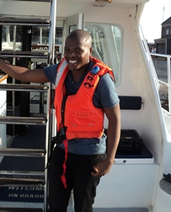
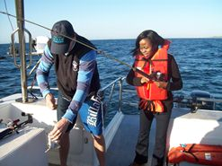
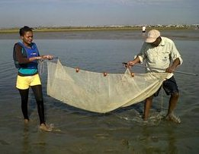
ACEP III (2012)– Split call:
Open call with transformation targets (67%)
Closed call for Postgraduate Marine Science students at Historically Black Universities (33%)
2012 – 12 Honours (R200K)
2013 – 10 Honours, 9 Masters, 2 PhDs (R1 mil)
35 postgraduate students by 2015

Slide 11
Phuhlisa Vision
Produce a winning model for the development of a pipeline of High Quality Human Capital in Marine Science by utilizing talent at HBUs of South Africa
Student development at HBU
Supervisor development (where required)
Building of key partnerships between NF’s and HBUs.

Slide 12
Positives at HBUs
Fast growing research culture
Very good Microbiology labs
Analytical expertise
Aquaculture
Geology
Good GIS platforms
Good and dedicated staff, eager students

Slide 13
Case analysis
Mediocre Research
Reduced research output
Low public awareness
Effects
Underfunded
Unemployment
Lack of transformation in Marine Science
Causes
Little incentive to change
Limited awareness/outreach
Historical & Socio-cultural
factors
Allure of other disciplines

Slide 14
Programme challenges
Geographic separation
Communication
Disparate financial and administration systems
WSU under administration
Under resourced and poorly maintained research equipment
Regular strike actions

Slide 15
Address challenges
ASSAf report (2010) barriers:
Poor quality schooling & high dropout rate
Poor monitoring to track progress
Institutional constraints: limited supervisory capacity
Financial & Administrative
The Phuhlisa Response
effective courses academic & professional development
Monthly online monitoring and reporting
Co-supervision by NF researchers, research platform provision (Boats, 4X4s, dive teams, ROV)
Dedicated resources, secure & adequate DST funding

Slide 16
Phuhlisa model

Slide 17
Critical success factors
HBU Supervisors centred approach
Recruitment of high talent/potential individuals
Address critical shortcomings and gaps through excellent effective courses
Adequate continuous funding
Ownership vs NF/HBU partnership
Quick wins vs sustainable growth
Greater integration at HBU departmental level

Slide 18
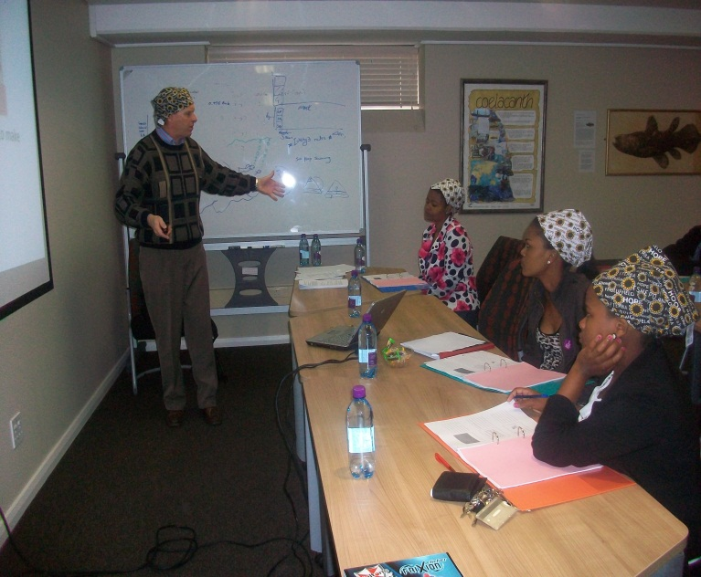
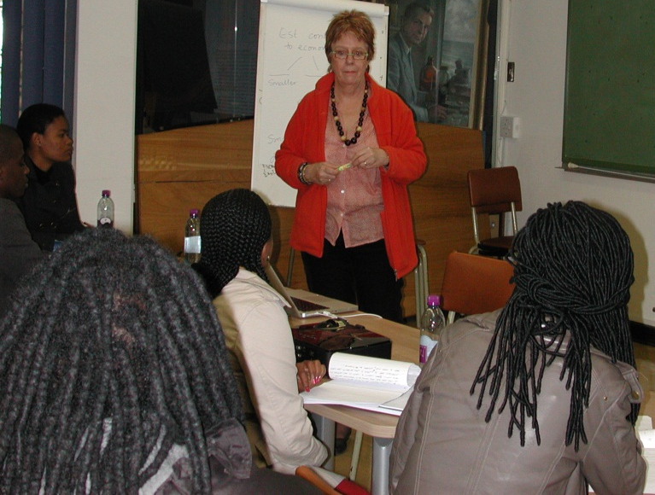
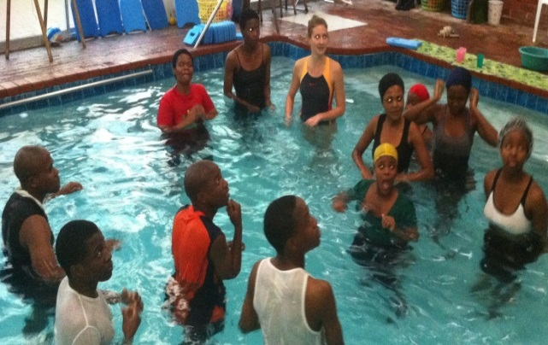
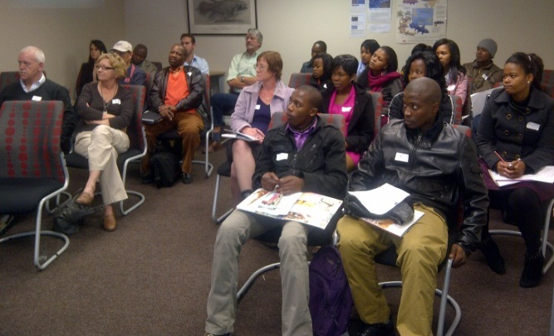
Courses
Scientific & Academic
Academic writing
Presentation Skills
Statistics, Basic Taxonomy
Lifeskills
First Aid, Swimming, Driving, Skippers license, diving

Slide 19
In conclusion…
ACEP Phuhlisa is a strategic initiative in the form of an intervention
Move towards equal partner collaboration between National Facility and Universities
Caring for the discipline will take more than passion and research excellence
Shape the next generation of South African Marine scientist through transformation

Slide 20
The End

Slide 21
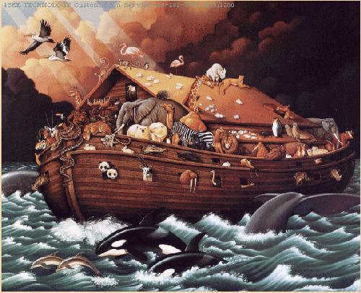
What is required?

Slide 22
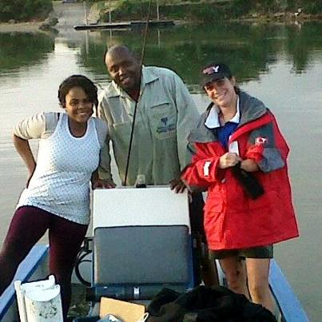
Marine Biology Lukhanyiso Vumazonke (UFH), Alexis Olds & Shaun Deyzel
Oyama Siqwepu
Investigating Ichthyofuana of the Sundays Estuary
Tumeka Mbobo
Studying hyperbenthic caridean shrimp, Palaemon peringueyi – Swartkops Estuary

Slide 23
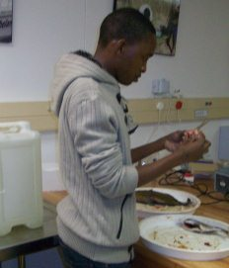
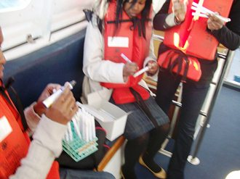
Microbiology Anna Clarke & Angus Paterson
Zikhona Jojozi & Sive Bukani
Screening of bacteria from gastrointestinal tracts of marine fish for potential use of probiotics
Lavious Matereke
Spatial analysis of pathogenic coliforms in the Swartkops River Estuary

Slide 24
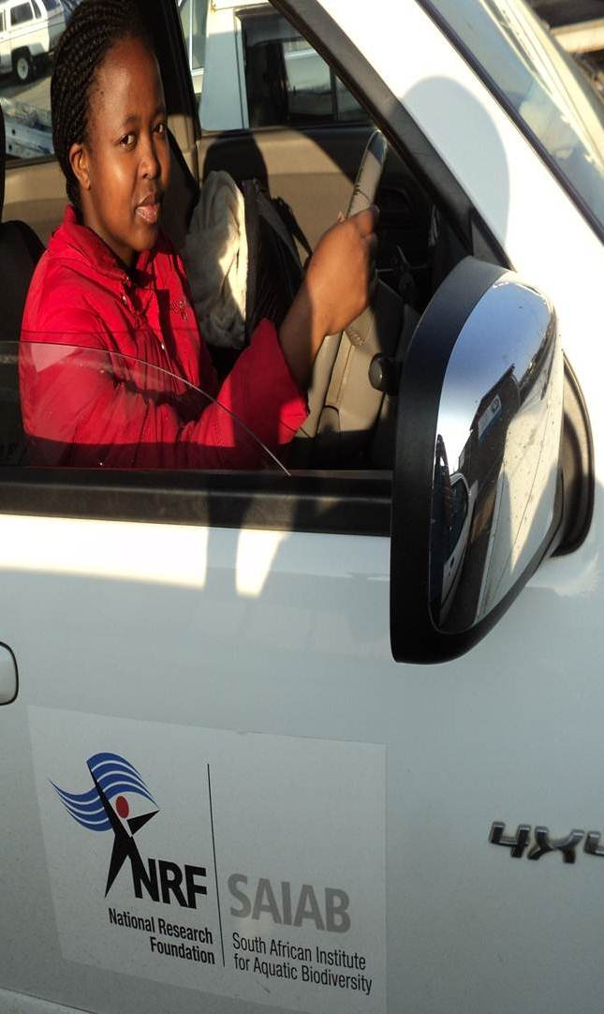
Marine Geology Ken Liu & Tommy Bornman
Sanele Ndzelu
Spatial Analysis of Bayscale changes in Particle size in Algoa Bay
Nondzuzo Zathelela
Spatial Analysis of Bayscale changes in Particle size in St Algoa Bay

Slide 25
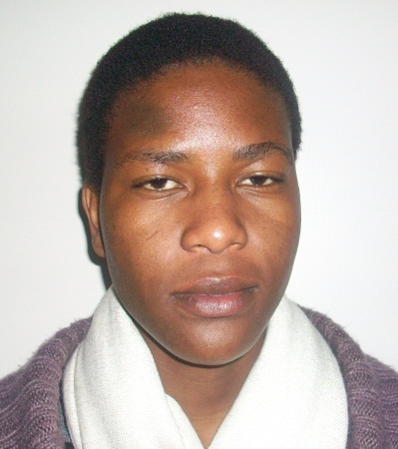
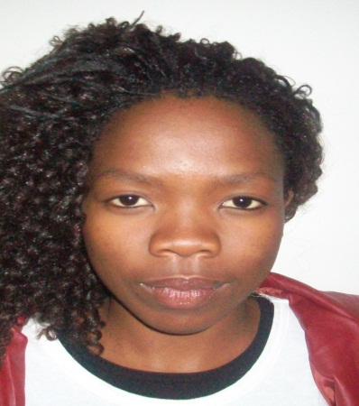
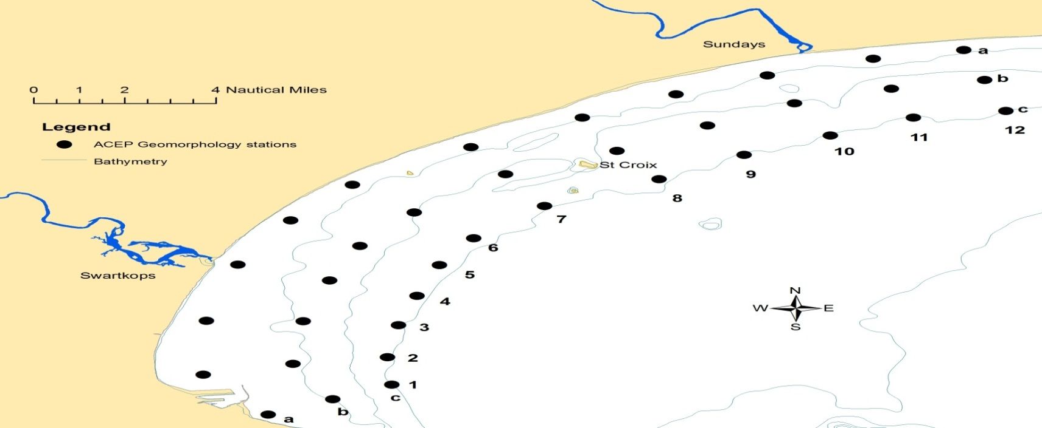
GIS Caryll Tyson & Tommy Bornman
Tivisani Ndlovu & Amanda Mlungwana
Spatial Mapping of Changes in Oyster Bay and St Francis Bay dune system over the years

Slide 26
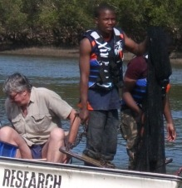
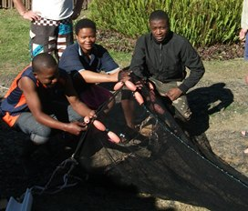
Estuarine Biology Emile Plumstead, Motebang Nakin & Shaun Deyzel
Yolanda Qhaji
Bentho-Palagic crustacean community associated with Sediment characteristics in Mngazana Estuary
Lwazi Nombembe
Spatial variation of Sediment characteristics and tidal volume in Mngazana Estuary
Sonwabile Malongwe
Bentho-Palagic ichthyofaunal coomunity associated with Sediment characteristics in Mngazana Estuary

