Slide 1
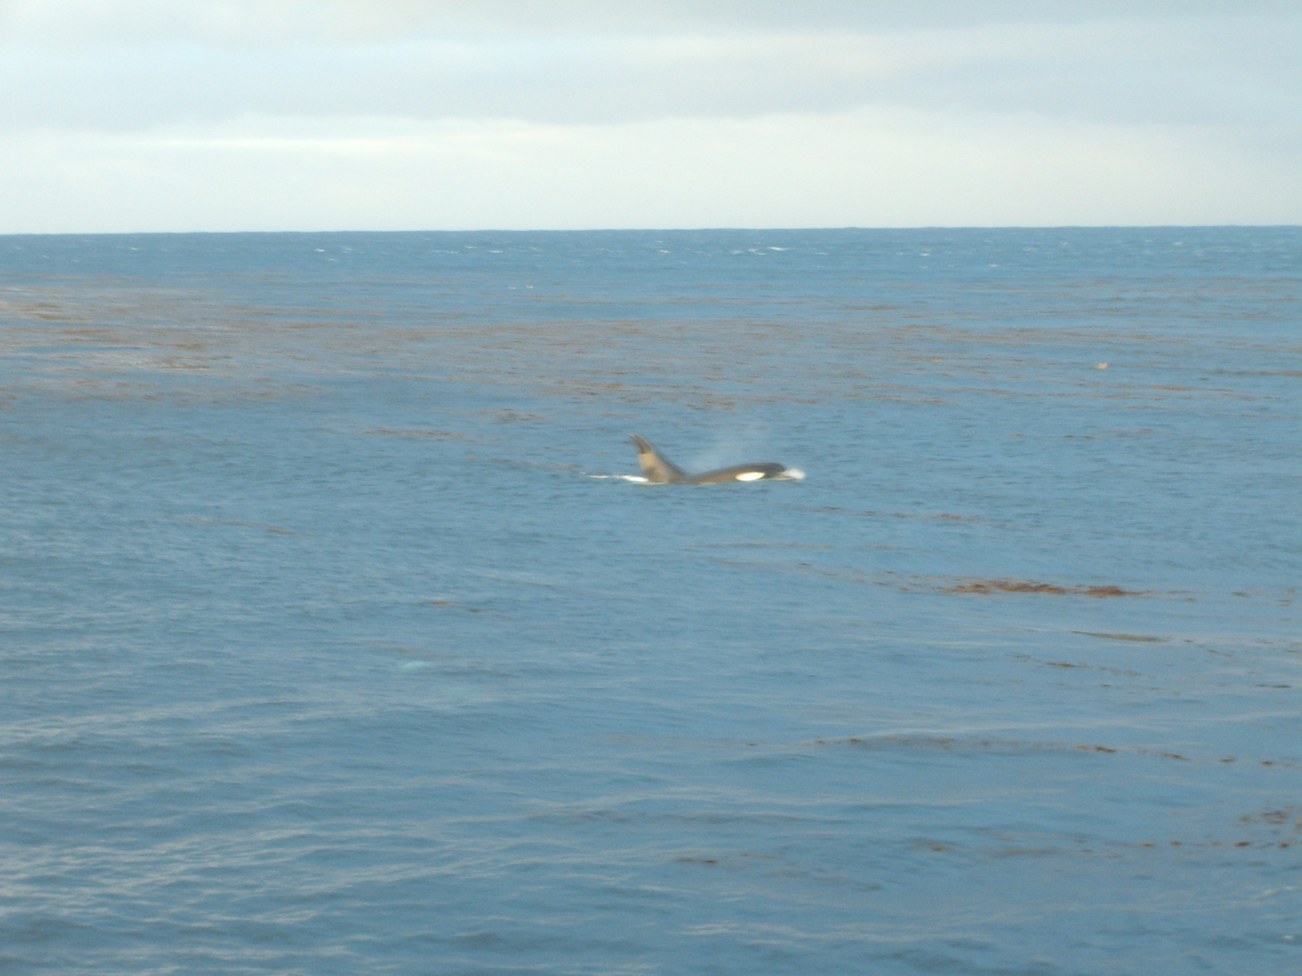
Transformation in marine science with regard to black women
by
Tshoanelo Miya (NEE: Moloi)
SANCOR Forum
11 June 2013

Slide 2
Background
Bsc Zoology

Slide 3
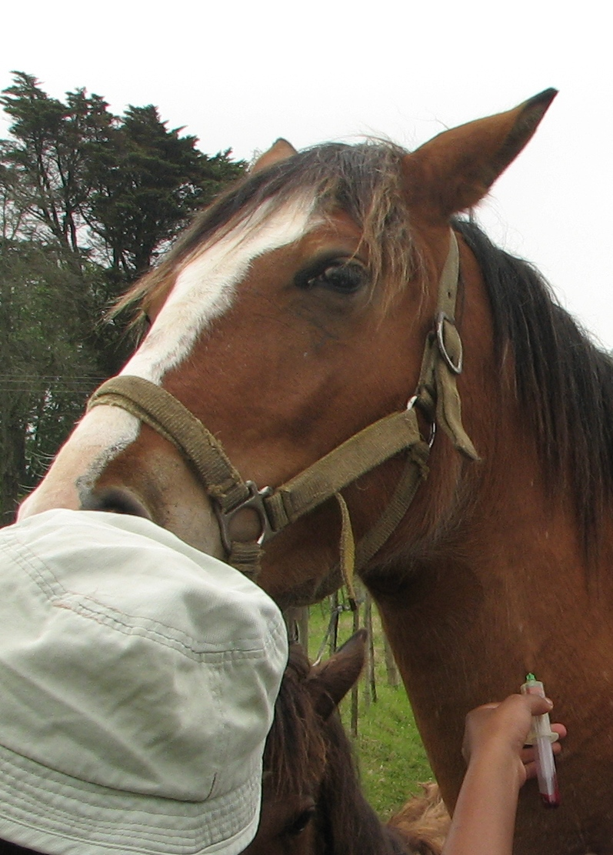
Background
Bsc Zoology
Honours and Masters in Veterinary parasitology

Slide 4
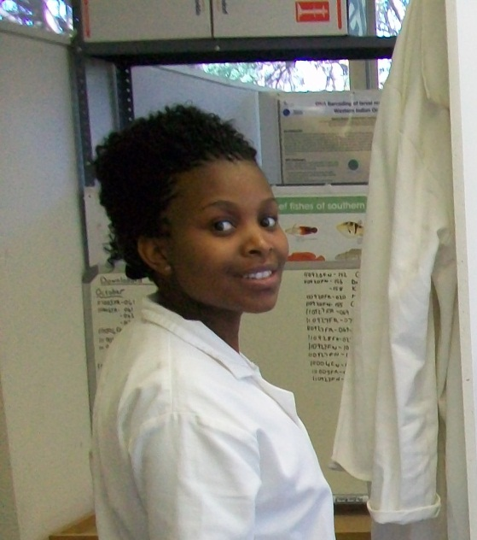
Background
Bsc Zoology
Honours and Masters in Veterinary parasitology
DST/NRF intern (2008/2009) at SAIAB
Winter school at SAIAB (2008)
Registered for PhD Ichthyology in 2010

Slide 5
Department of Ichthyology and Fisheries Science (DIFS) graduate students at Rhodes University
2010
2011
2012
2013

Slide 6
DIFS S. African black women students
2010
2011
2012
2013

Slide 7
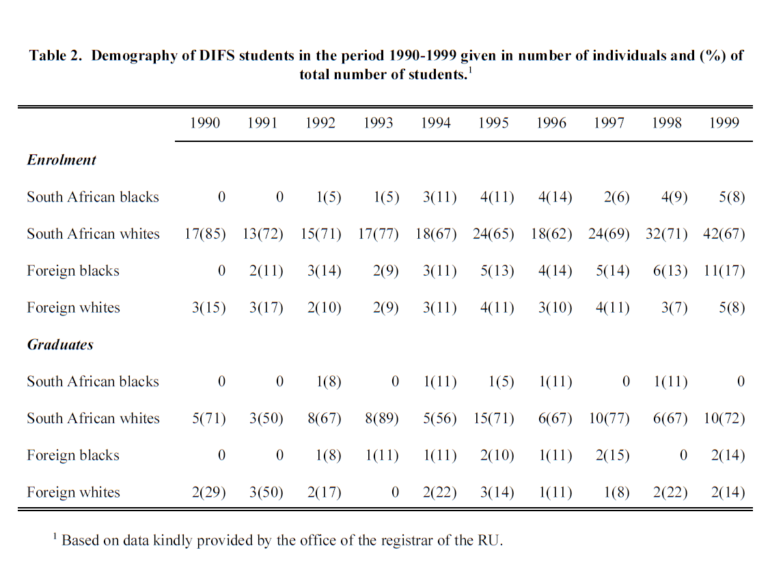
Ofer’s MSc thesis

Slide 8
Possible reasons
Lack of exposure to the marine environments.
Traditional constraints.
Family pressure.

Slide 9
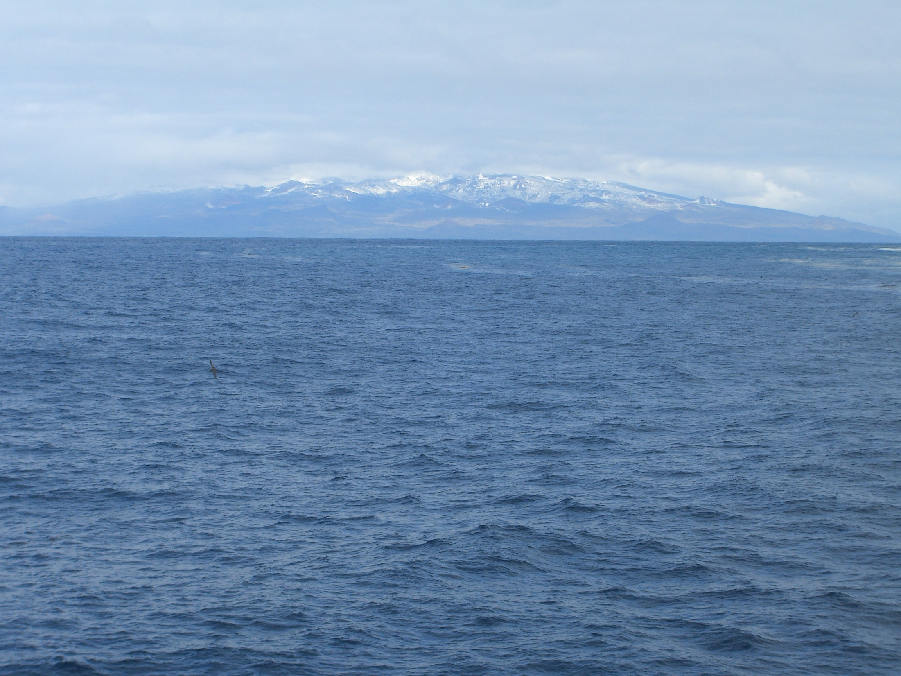
PhD research project
Molecular systematics and antifreeze biology in sub-Antarctic notothenioid fishes.
Supervisors: Monica Mwale, Ofer Gon and Christina Cheng
Funders: South African National Antarctic Programme (SANAP)/NRF; and SAIAB

Slide 10
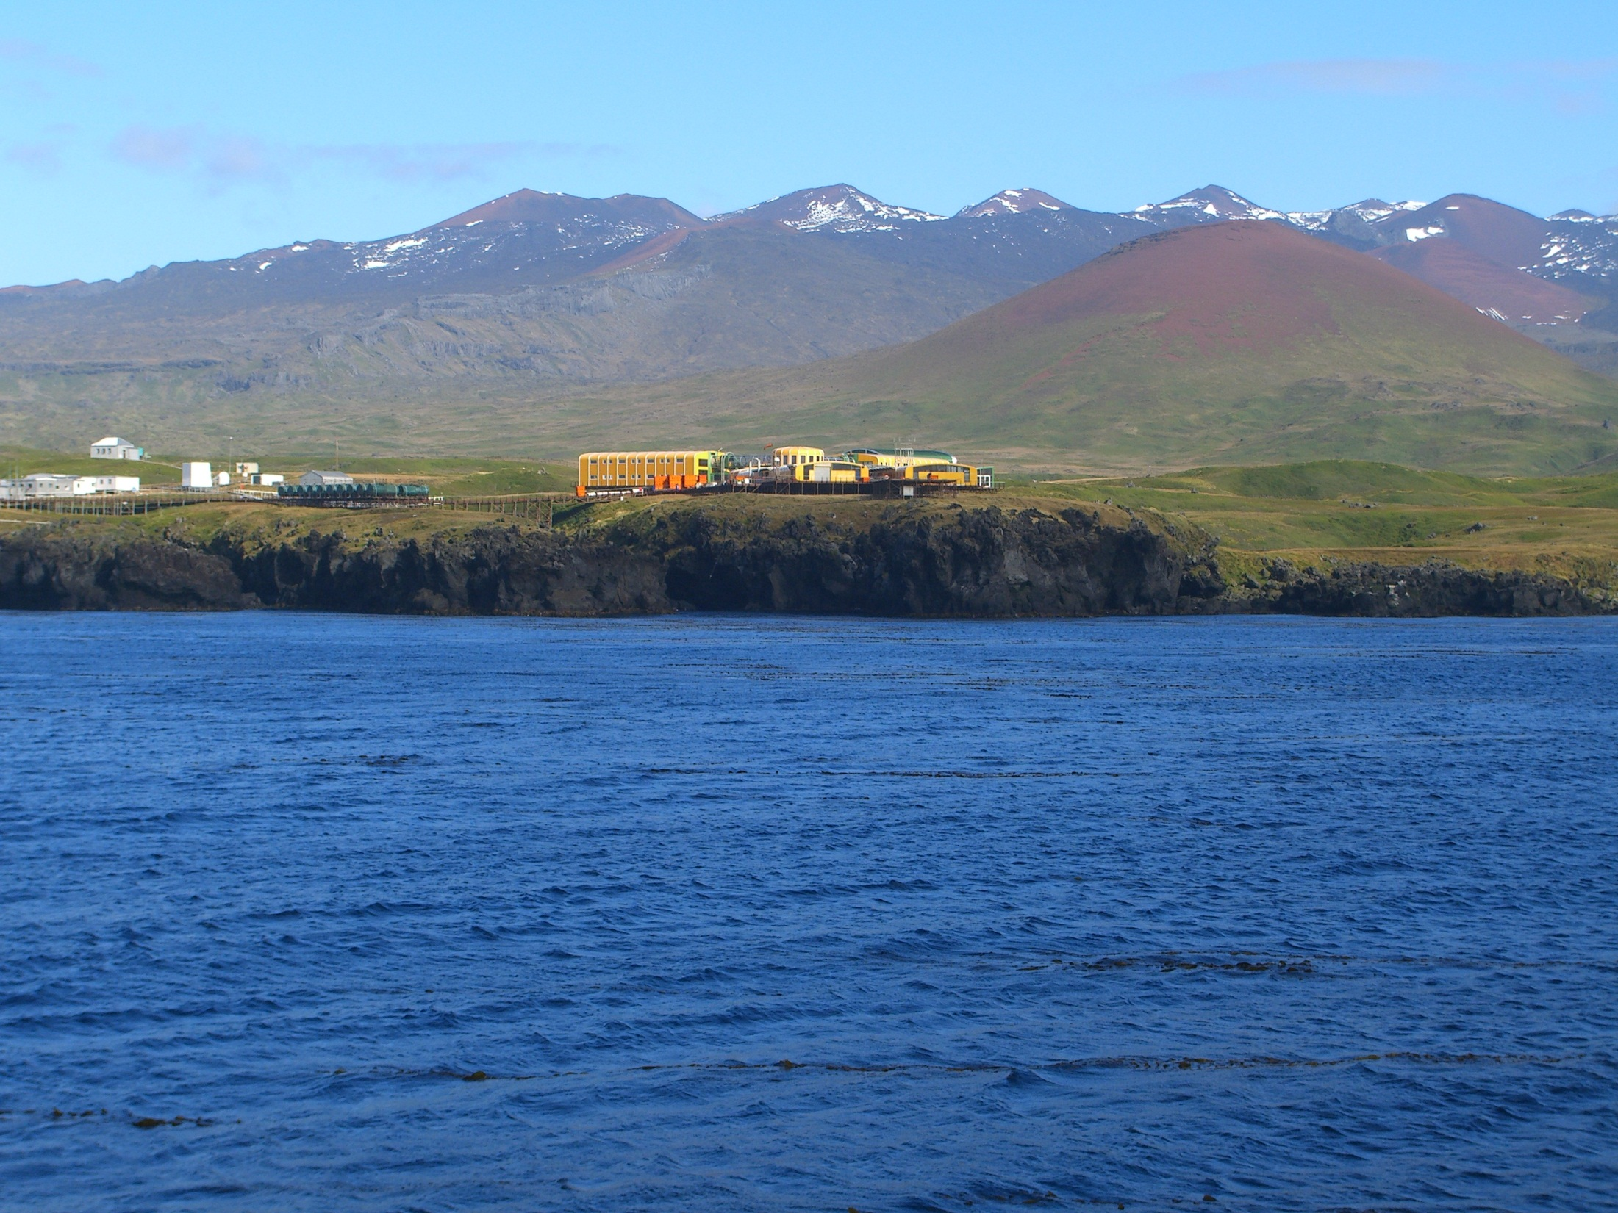
Prince Edward Islands
Annexed by South Africa in 1947-1948.
First non-white scientist: Gerald Meyer in 1989.
First non-white woman scientist: Samantha Linnerts in 2003.
Black students also joint in from late 90’s:
  Lukhanyiso Vumazonke in 2002.
Research:
    Biological and environmental
    Weather data collection (inland and ocean)
Ref: John Cooper. 2008. Human History. In: The Prince Edward Islands land-sea interactions in a changing ecosystem, eds.: Steven L Chown & Pierre W Froneman. pp. 331-350.

Slide 11
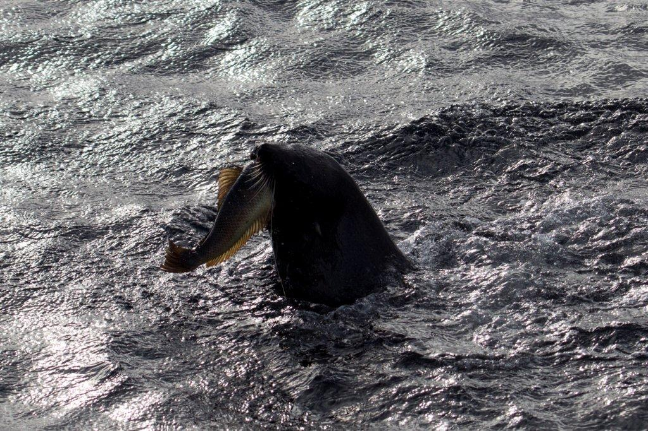
Fish research at Prince Edward Islands
Fish fauna:
  Gon & Klages (1988); Gon & Moster (1992)
  33 species and 13 families
  Misidentification in Nototheniidae
Antifreeze biology of the Notothenioids
  Gon et al (1994):
  Antifreeze in Notothenia coriiceps

Slide 12
Aims
Re-evaluation of the taxonomic status of widespread notothenioid species at DNA level.
To determine the functional status of antifreeze systems of sub-Antarctic species at protein and gene level.

Slide 13
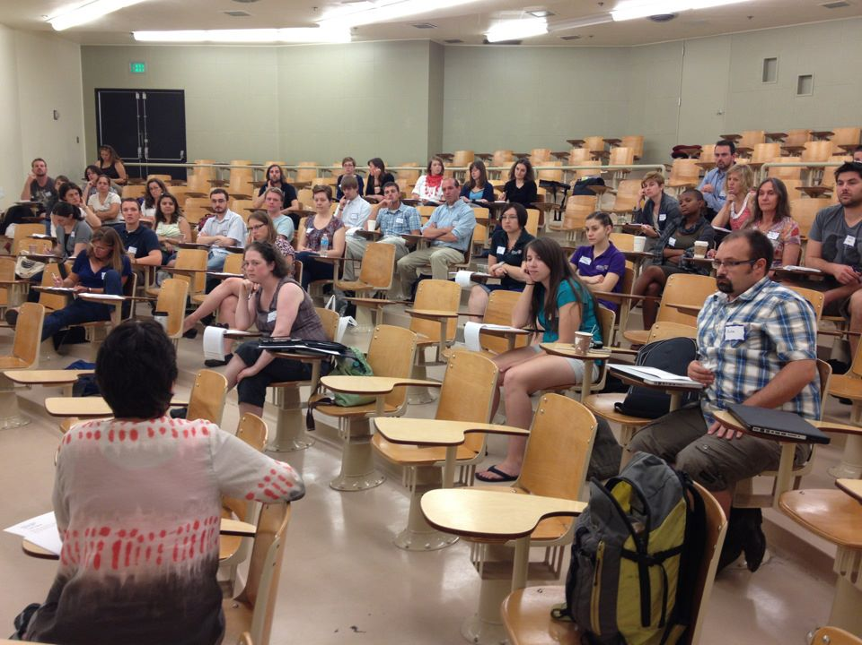
Characterization of the freezing avoidance attributes of the sub-Antarctic notothenioid species
Scientific Committee on Antarctic Research (SCAR) XXXII open conference, July 2012, USA.

Slide 14
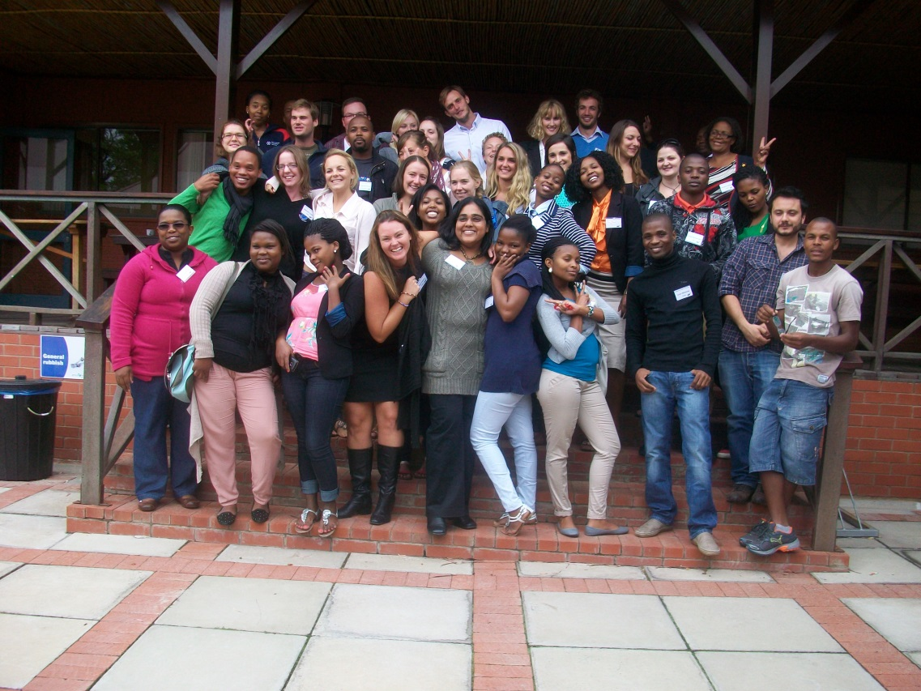
Characterization of the freezing avoidance attributes of the sub-Antarctic Notothenioid species
Scientific Committee on Antarctic Research (SCAR) XXXII open conference, July 2012, USA.
Eastern Cape SANCOR student workshop, March 2013, Rhodes University

Slide 15
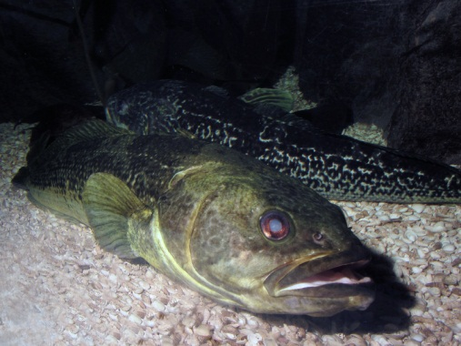
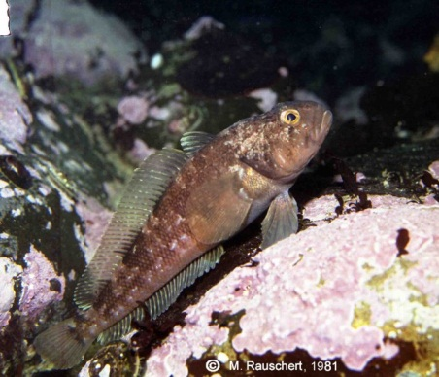
The effect of habitat temperature on serum antifreeze glycoprotein (AFGP) activity in Notothenia rossii (Pisces: Nototheniidae) in the Southern Ocean.
Tshoanelo Miya ∙ Ofer Gon ∙ Monica Mwale ∙ C. –H. Christina Cheng

Slide 16
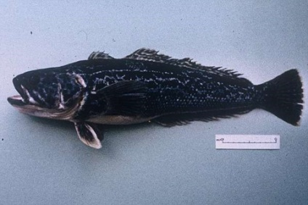
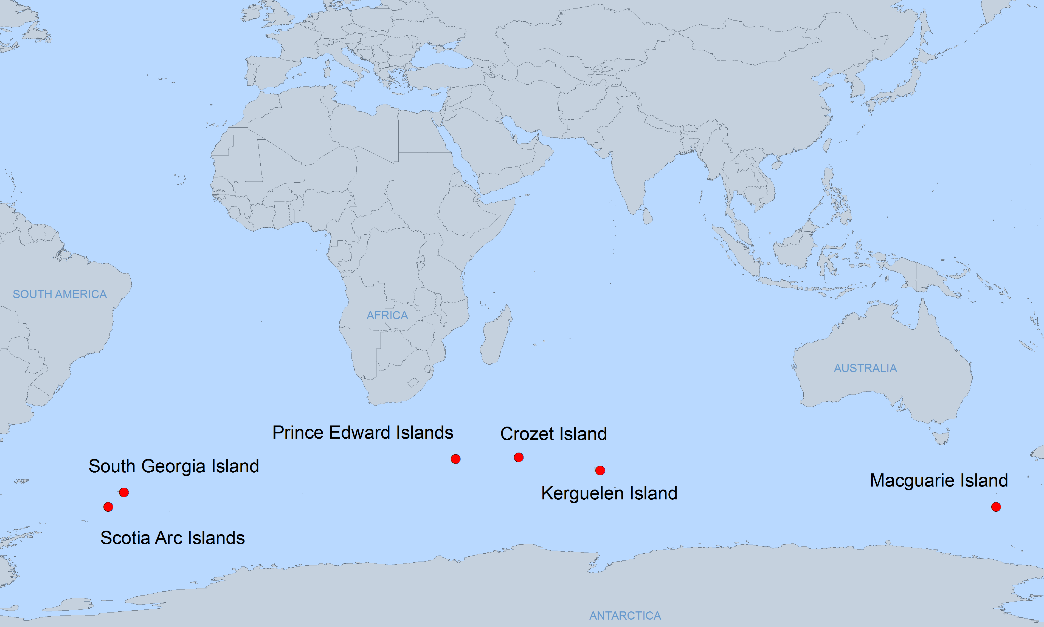
Distribution
Notothenia rossii
N. rossii marmorata
N. rossii rossii

Slide 17
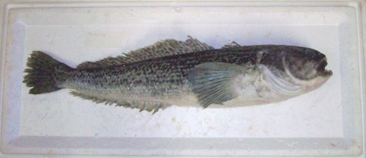
Notothenia rossii
Found in water temperatures ranging between -1.5 to 8 °C.
Fishes residing in the temperatures below 0 °C needs freezing avoidance mechanism.
They evolved antifreeze glyco-protein (AFGP) to avoid freezing.
Species inhabiting water temperature above freezing need no AFGP in their body fluid.
However, Gon et al. (1994) found that Notothenia coriiceps of Marion Island have similar distribution of the same AFGPs found in Antarctic Peninsula specimen.

Slide 18
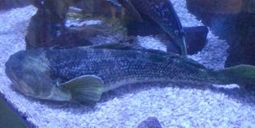
Aim
AFGP activity is known to differ among notothenioid species residing in different environmental conditions.
AFGP trait among populations of a geographically widely distributed species is unknown.
This study investigates the effect of thermal habitat on the AFGP trait among N. rossii populations distributed at the different latitudes of the Southern Ocean.

Slide 19
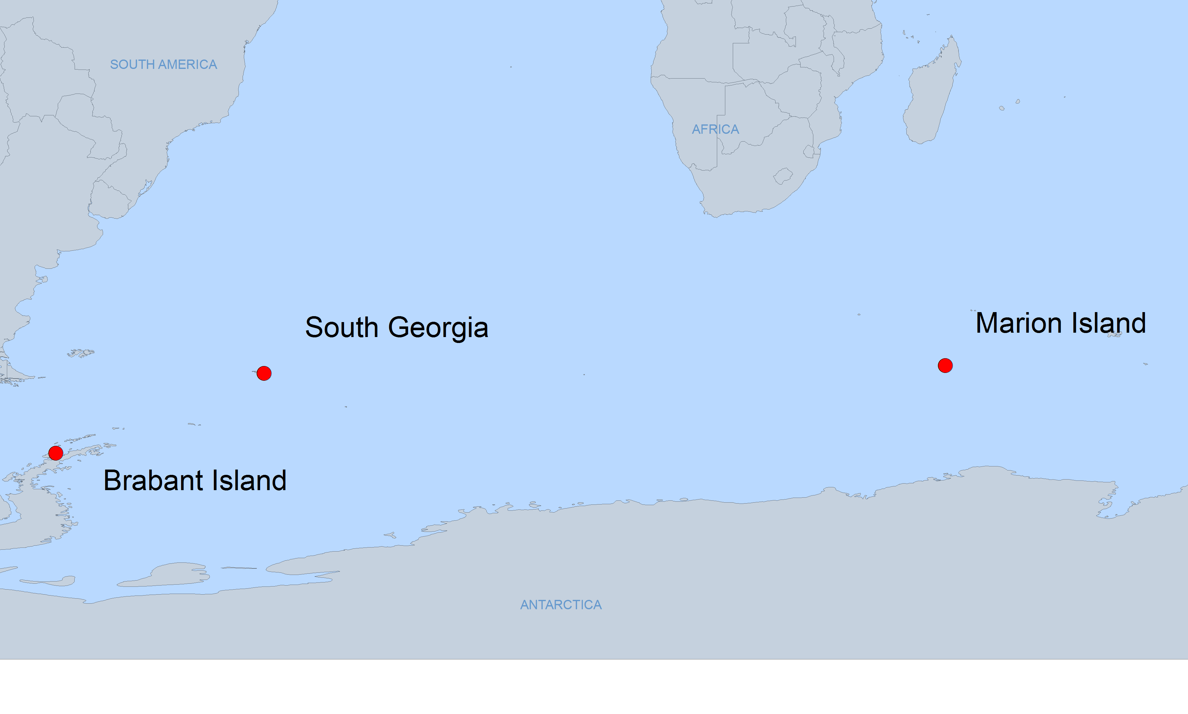
Study area
12 Notothenia rossii specimens
(-0.4 to 5°C)
Ob’ Seamount (4 to 8°C)
South Shetlands (-1 to 2°C)
Dallman Bay (-1.4 to 2°C)

Slide 20
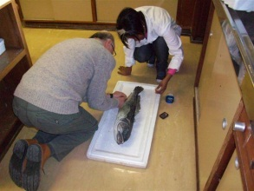
Materials and Methods
Blood serum samples were collected.

Slide 21
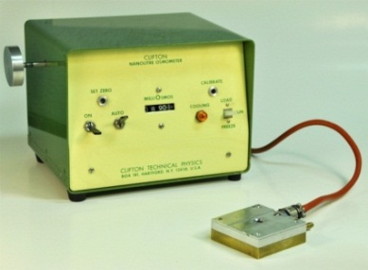
Materials and Methods
Blood serum samples were collected.
Serum AFGP activity determination
  Thermal hystersis: difference between melting and freezing point, using Clifton Nanolitre Freezing point Osmometer.
Nanolitre

Slide 22
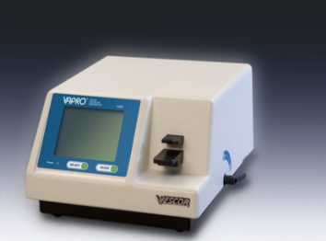
Materials and Methods
Blood serum samples were collected.
Serum AFGP activity determination
  Thermal hystersis: difference between melting and freezing point, using Clifton Nanolitre Freezing point Osmometer.
Serum osmolality: measures the concentration of the dissolved solutes in blood serum, using Wescor 5520 vapor pressure osmometer.
Equilibrium freezing point was determined by multiplying osmolality by -0.001858 °C mOsm⁻¹
Wescor 5520

Slide 23
Results
Location | n | Osmolality (mOsm) | Equilibrium Freezing Point (ᵒC) | Melting Point (ᵒC) | Non-equilibrium Freezing Point (ᵒC) | Thermal Hysteresis (ᵒC) | Serum AFGP concentration (mg/mL)
Ob’ Seamount | 1 | 482±1 | -0.90 | -0.94±0.03ª | -1.39±0.05ª | 0.44±0.03ª | 4.88
South Georgia | 5 | 421±15 | -0.78±0.03 | -0.82±0.03 | -2.08±0.18 | 1.26±0.18 | 11.63±1.28
South Shetland | 5 | 502±49 | -0.93±0.09 | -1.00±0.08 | -2.08±0.10 | 1.08±0.12 | 10.97±1.95
Dallman Bay | 2 | 416±6 | -0.77±0.01 | -0.80±0.03 | -2.22±0.16 | 1.43±0.16 | 14.89
Where appropriate values are listed as average and standard deviation of technical replicates.
ªThe value was the average of three separate determinations of the single sample.

Slide 24
Results
Location | n | Osmolality (mOsm) | Equilibrium Freezing Point (ᵒC) | Melting Point (ᵒC) | Non-equilibrium Freezing Point (ᵒC) | Thermal Hysteresis (ᵒC) | Serum AFGP concentration (mg/mL)
Ob’ Seamount | 1 | 482±1 | -0.90 | -0.94±0.03ª | -1.39±0.05ª | 0.44±0.03ª | 4.88
South Georgia | 5 | 421±15 | -0.78±0.03 | -0.82±0.03 | -2.08±0.18 | 1.26±0.18 | 11.63±1.28
South Shetland | 5 | 502±49 | -0.93±0.09 | -1.00±0.08 | -2.08±0.10 | 1.08±0.12 | 10.97±1.95
Dallman Bay | 2 | 416±6 | -0.77±0.01 | -0.80±0.03 | -2.22±0.16 | 1.43±0.16 | 14.89
Where appropriate values are listed as average and standard deviation of technical replicates.
ªThe value was the average of three separate determinations of the single sample.

Slide 26
Discussion
AFGP levels can be modulated in response to surrounding temperature and sea-ice.
The Ob’ Seamount N. rossii (4.88 mg/mL) possesses substantial levels of AFGPs.
N. rossii have recent origin in the warmer environments.
The magnitude of AFGP phenotype varies in space and time.
It is governed by the thermal environment species experience in relation to their geography as well as by evolutionary time.

Slide 27
In conclusion
What be done to attract more blacks into marine science?
Introduce marine science to high school learners.
Funding for undergraduate students.
Adjust post-graduate funding to be attractive.

Slide 28
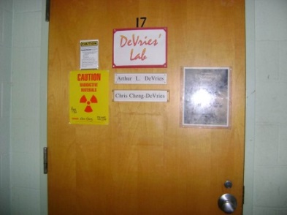



Acknowledgement
DeVries Lab at the University of Illinios, USA.
Funders
  SANAP/NRF grant.
  SAIAB.
  United States National Science Foundation-Office of Polar Program (US NSF-OPP) grant.
Department of Ichthyology and Fisheries Sciences, Rhodes University.

